Slide 1

The impact of trauma on mind and body in eating disorders: lessons for the psychotherapeutic field
Johan Vanderlinden, PhD
Faculty of Psychology and Educational Sciences
KULeuven, Belgium
Email johan.vanderlinden@kuleuven.be
www.upckuleuven.be

Slide 2
Goal and summary of lecture
What do we actually know about the link between trauma and eating disorders?
What is impact of trauma on the body and mind in eating disorders?
What are the obstacles and challenges in the psychotherapeutic work with clients with a history of complex trauma?
What kind of treatment is indicated in these patients?
Show some FU data of clients with complex trauma and dissociative symptoms
Most important: to stimulate personal reflection on our therapeutic practices

Slide 3
Introduction
Eating disorders are complex and serious ilnesses with mortality rates higher than any other psychiatric disorder
ED’s affect between 0,9-4% of women and 0,3% of men
Outcomes (less then 50% recover) remain unacceptably low

Slide 4

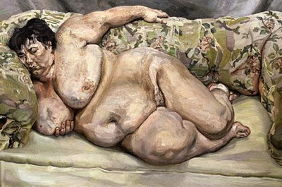
Eating disorders are about bodies and they communicate with their bodies

Slide 5
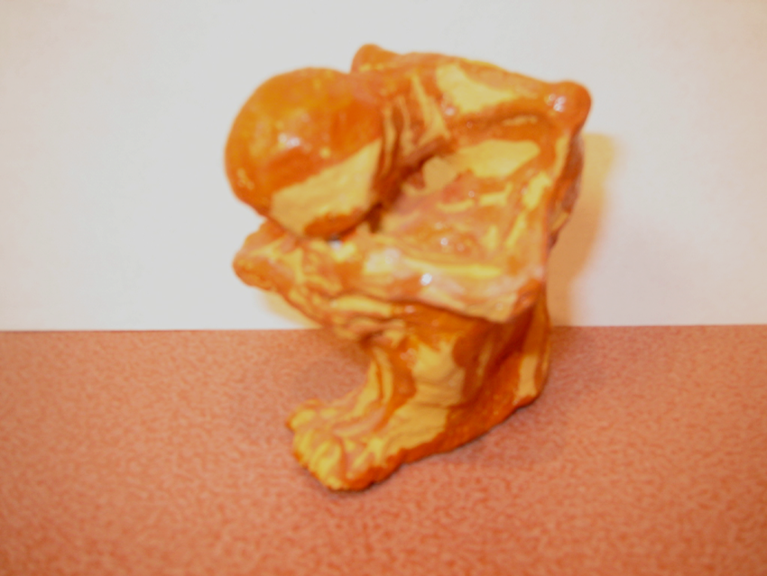
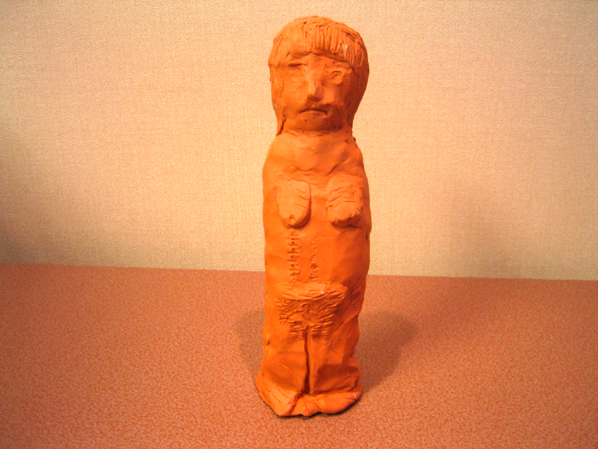
Often sad bodies with scarves and pain

Slide 6
Trauma and the Eating Disorders (ED’s)
Psychiatric comorbidity is the norm in the assessment and treatment of ED’s
Traumatic events and lifetime PTSD are often major drivers of these challenging complexities

Slide 7
Some clinical cases
Laura is a 26 years old bulimic patient
She asks for help for her daily binges and vomiting
An evidence-based Cognitive Behavioural step-by step approach is started

Slide 8


TREATMENT PROTOCOL FOR BULIMIA NERVOSA (CBT-enhanced) (Vanderlinden et al , 2004)

Slide 9
CBT out-and inpatient protocol for ED in University Psychiatric Center KULeuven Campus Kortenberg Belgium
Sessions
1 | 2 | 3 | 4 | 5 | 6 | 7 | 8 | 9 | 10 | 11 | 12 | 13 | 14 | 15 | 16 | 17 | 18 | 19 | 20 | 21 | 22 | 23 | 24
Preparing for change
Psychoeducation and evaluation of motivation
 |  | Therapy contract
 |  | Fase 1: Normalisation eating pattern
 |  | Normalisation eating habits
 |  | Weight control and eating diary
 |  | Stop dieting
 |  | Stop all compensatory behaviors
 |  | Progressively decrease number on binge eating episodes and introduce self-control techniques
 |  | Explore triggers of binge eating in here and now situation
 |  | Learn alternatives to cope with trigger situations provoking binge eating
 |  |  |  |  |  |  |  |  |  |  |  | Fase 2: Modules focusing on different factors who maintain the eating disorder (3 or more modules)
 |  |  |  |  |  |  |  |  |  |  |  | Module 1 cognitions & behaviors
 |  |  |  |  |  |  |  |  |  |  |  |  |  | Module 2 Body experience
 |  |  |  |  |  |  |  |  |  |  |  |  |  |  |  | Module 3 Self-esteem
 |  |  |  |  |  |  |  |  |  |  |  |  |  |  |  |  |  | Module 4 Autonomy
 |  |  |  |  |  |  |  |  |  |  |  |  |  |  |  |  |  |  |  | Module 5 Emotions
 |  |  |  |  |  |  |  |  |  |  |  |  |  |  |  |  |  |  |  |  |  | Module 6 Prevention of relapse
Diagnostic Evaluation |  |  |  |  |  | Evaluation |  |  |  |  |  | Evaluation

Slide 10
Evolution of the CBT Therapy in Laura
The CBT therapy helped in reducing the daily binge episodes and the vomiting but Laura still continued to have some bulimic episodes every week
She explains that something inside her forces her to go on with the bingeing and vomiting
This something: I can NOT express into words

Slide 11
The story of Greet
Greet, 28 years of age, was also referred with anorexia nervosa of the restricting type but at the same time showed a very strange problem with her toes on both feet
Her toes started to take a bizar, spectacular position and it was extremely painful
Medical doctors only solutions: amputation of a part of the toes

Slide 12
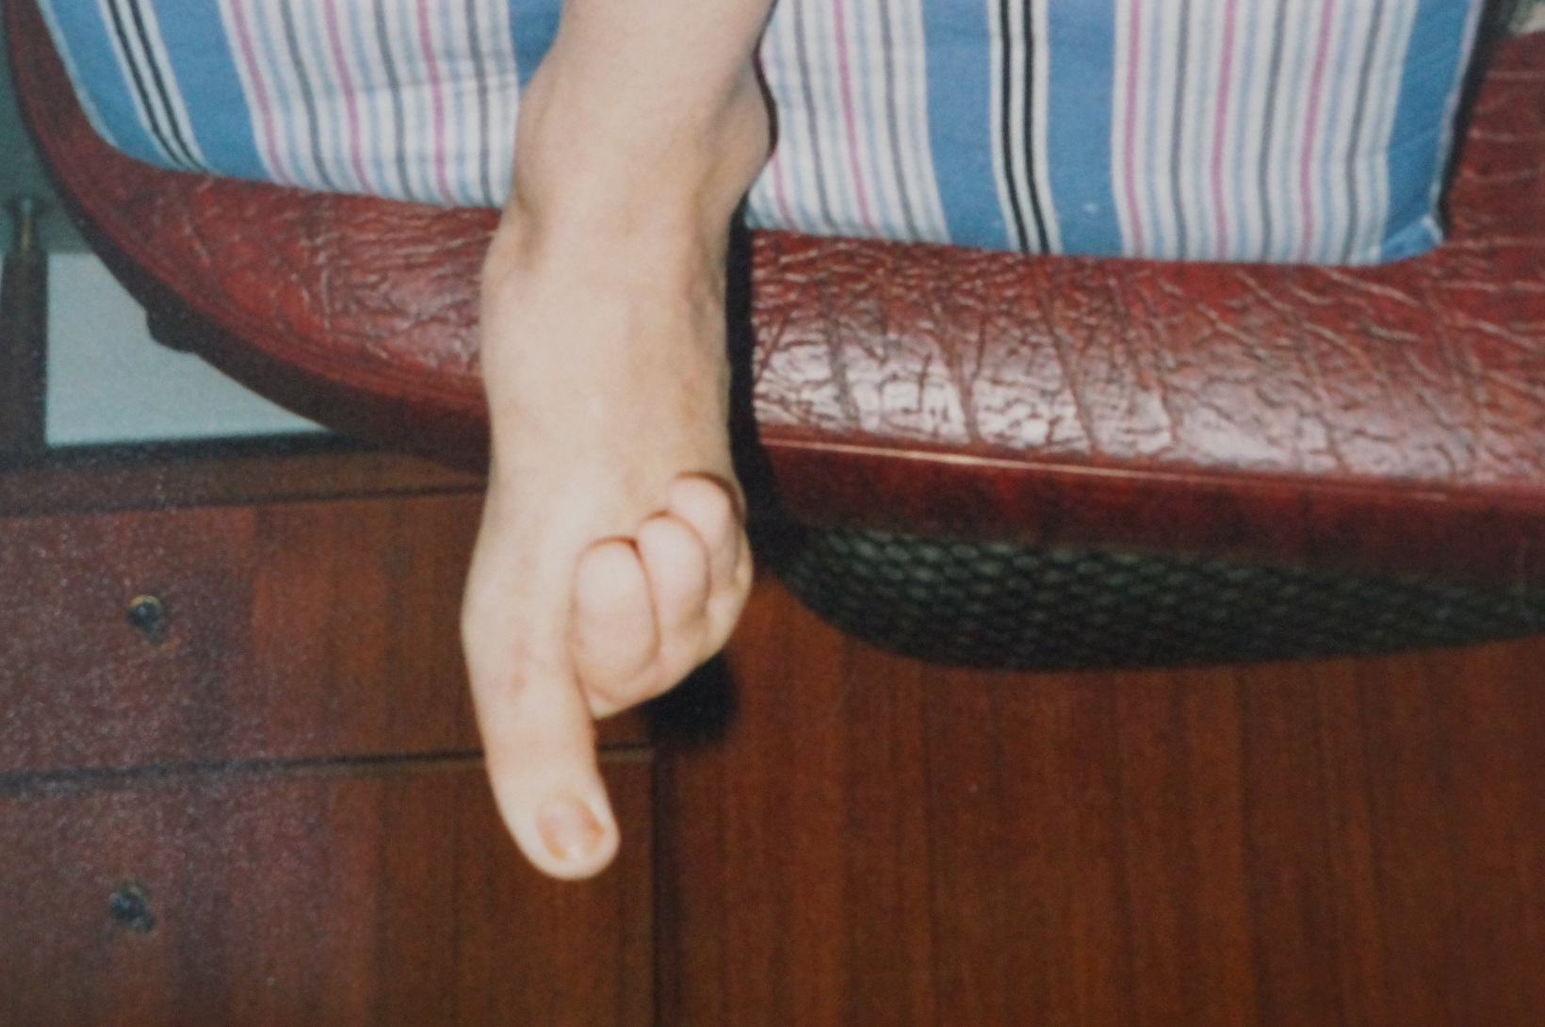

Slide 13
The story of JENTE
JENTE, 17 years old anorexia nervosa of the bingeing-purging type
Abused at the age of 6-10 by friend of the family
Grows up in a family with traumatised parents
Developed the anorexia at age 16, after contact with boy (trigger bringing back the memory of the abuse)

Slide 14
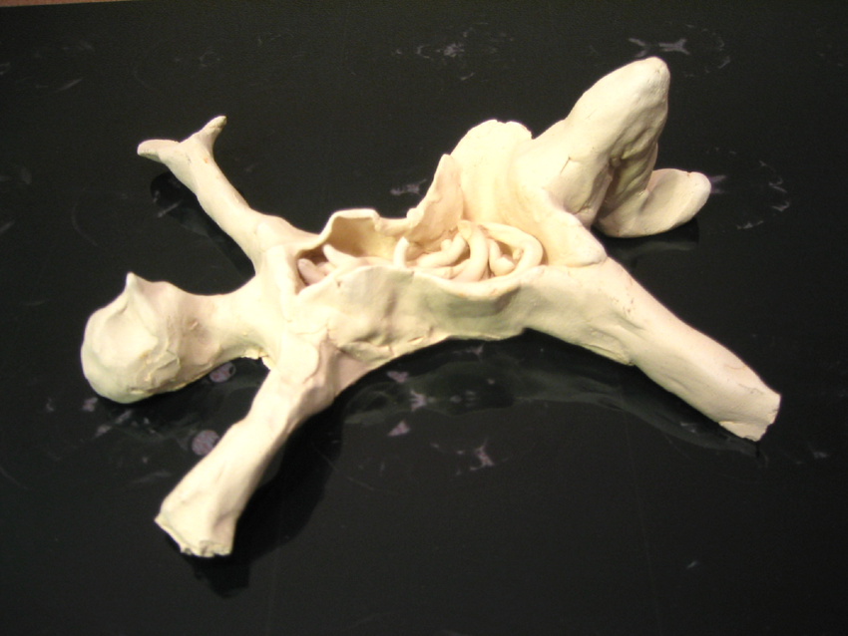

Slide 15
JENTE
Fasting at age 16
anorexia with
bingeing/purging
Physiological
Hyper-arousal:
Stress and pain in belly
Triggers:
Boys/Men
Certain foods
Night/dark
Movie
Naked…
Feelings
Hopelessness
Despair
Anger
Aggressive
Lonely
Anxious
Insecure
….
FAMILY
Multi-problem
family
Depression
PTSD symptoms
Dissociation
Auto-mutilation
Alcohol-abuse
Negative beliefs:
I am bad
I am guilty
I am in danger
Avoidance behaviour
No feelings in the body
Dresses wide clothes
No social contacts
Never goes out
Extreme hyperactivity
No shower
…..
Sexual abuse
by friend of
family (age6-10), flashbacks

Slide 16
How can we define trauma? What kind of traumatic experiences are traumatic?

Slide 17
APA definition=very narrow view of trauma
This definition of trauma is unfortunately quite limited and does not involves the more ‘hidden’ traumata
e.g. growing up in invalidating family environments with poor attachment, confrontation with death and loss, emotional abuse and maltreatment, parentification, bullying experiences, leaving home experience, frequent critical comments from the parents or peers, etc…
These hidden traumata are often not so spectacular but even more complicated to assess and have received much too little attention in the literature.
Pignatelli AM, Wampers M, Loriedo C, Biondi M, Vanderlinden J.(2017). Childhood neglect in eating disorders: A systematic review and meta-analysis. J Trauma Dissociation: 18(1):100-115. doi: 10.1080/15299732.2016.1198951.

Slide 18
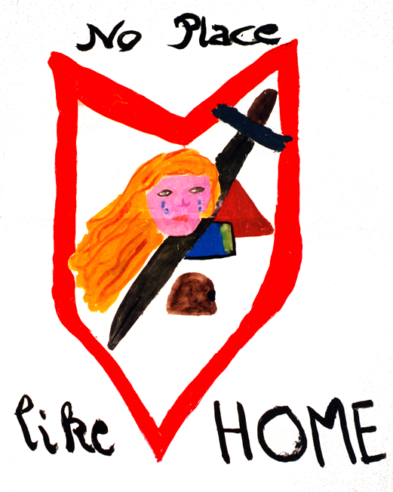

Slide 19
What about traumatic experiences in eating disorders?

Slide 20
Study 1: Traumatic experiences (TECH, Nijenhuis, van der Hart & Vanderlinden, 1999) and Chi-square comparison between different diagnostic groups (N=298) (Bronckaerts, B., Schotte, Ch., , Probst, M. & Vanderlinden, J. (2007). De impact van traumatische ervaringen op het psychologisch functioneren van eetstoornissen. Tijdschrift Directieve Therapie, 27, 270-294.
Traumatic Experiences | Total (n=298) | AN-R (n=139) | AN-M (n=67) | BN (n=92) | X²
Emotional neglect | 33.3 | 21.6 | 49.3 | 39.6 | 17.87 ***
Emotional abuse | 33.3 | 25.9 | 41.8 | 38.5 | 6.70*
Physical abuse | 11.8 | 8.6 | 17.9 | 12.2 | 3.75
Sexual Harrassment | 19.6 | 9.4 | 31.3 | 26.7 | 17.98 ***
Sexual Abuse | 14.8 | 7.2 | 28.4 | 16.5 | 16.34 ***
*=p<.05. **=p<.01. ***=p<.001 AN-R= restricting type; AN-M= bingeing-purging type; BN= Bulimia Nervosa

Slide 21
Differences between trauma (n=214) and non-trauma group (N=84) (Bronckaerts, B., Schotte, Ch., , Probst, M. & Vanderlinden, J. (2007). De impact van traumatische ervaringen op het psychologisch functioneren van eetstoornissen. Tijdschrift Directieve Therapie, 27, 270-294. )
Overall : 72% report some form of trauma: mostly emotional abuse
The trauma group has a significant longer duration of illness (M=4.3±4.1 versus 2.5±2.5)
After controlling for duration of illness: trauma group scores significantly higher on all measures including : Eating Disorder Inventory Body Attitude Test Symptom Checklist (SCL-90) and Dissociation Questionnaire (DIS-Q)

Slide 22
Research in eating disorders is showing that a history of trauma is associated with:
(1) a specific type of eating disorders characterised with bingeing and purging
(2) dissociative phenomena
(3) impulse dyscontrol problems (behavior and mood)
(4) personality disorders for instance borderline type in combination with interpersonal problems, depression, PTSD…

Slide 23
FINDINGS in a recent meta analysis in 13059 ED clients Molendijk, M. L., Hoek, H. W., Brewerton, T. D., & Elzinga, B. M. (2017). Childhood maltreatment and eating disorder pathology: a systematic review and dose-response meta-analysis. Psychological Medicine, 1-15. doi:10.1017/S0033291716003561
Molendijk and collegues (2017) reported that the prevalence rates of CSA, CPA and CEA were respectively, 31%, 26% and 45% for all ED categories
The prevalence rates of any childhood trauma for each type of ED was higher (21–59%) than those reported by healthy (1-35%) and psychiatric (5-46%) control groups
ED patients with CM were more likely to be diagnosed with a co-morbid psychiatric disorder and to be suicidal relative to ED subjects who were not exposed to CM.
ED subjects exposed to CM reported an earlier age of ED onset, a more severe form of their illness and more frequent binge-purge behaviors compared to ED subjects who did not report CM (Molendijk, et al, 2016).

Slide 24
Research is further showing (Casilini, M ., Bartoli, F ., Crocamo, C ., Dakanalis, A ., Clerici, M ., & Carrà, G . (2016). Disentangling the association between child abuse and eating disorders: A systematic review and meta analysis. Psychosomatic Medicine, 78(1), 79–90.)
Emotional and sexual abuse results in deficits in emotion regulation and/or behavioral control reflected by dissociative symptoms, impulsivity and compulsivity
These symptoms may have a function in both the development and maintenance of the eating disorder
Early attachment experiences (the quality of interpersonal relationships), negative self-referencing beliefs (involving shame and guilt), and dissociation may function as mediating factors between the trauma experience and the development of the Eds (Rabito-Alcon, MF, Baile & Vanderlinden, 2021)

Slide 25
What is the impact of trauma on our brain? What do we know?

Slide 26
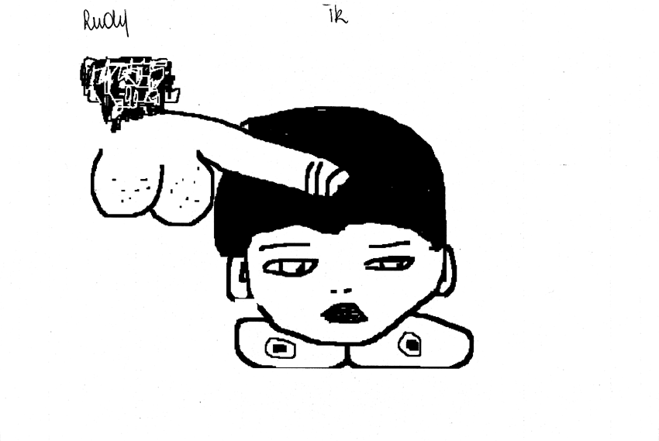

Slide 27
What is the impact of trauma on our brain? Finding nr 1
When traumatised people are confronted with images, memories, sounds, smells, and/or sounds related to their particular experience
AMYGDALA REACTS WITH ALARM and triggers a cascade of stress hormones in the brain, higher blood pressure, higher heart rate, preparing the body for fight or flight

Slide 28
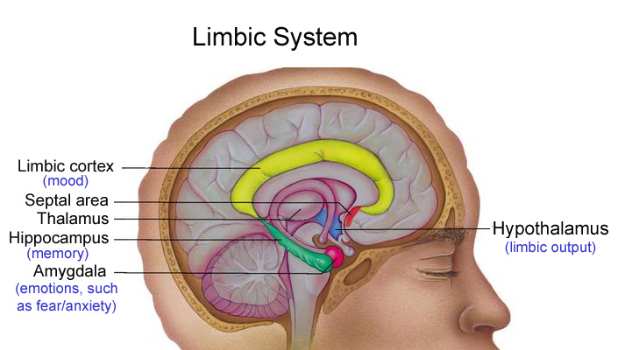

Slide 29
What is the impact of trauma on our brain? Finding nr 2
At the same time : BROCAS’s area (our speech center) goes OFFLINE
People are confronted with a state of speechles, not able to talk/speak about what is happening
This can explain why many trauma victims find it difficult to tell their story while the body experiences intense feelings of rage and anger, helplessness and anxiety

Slide 30
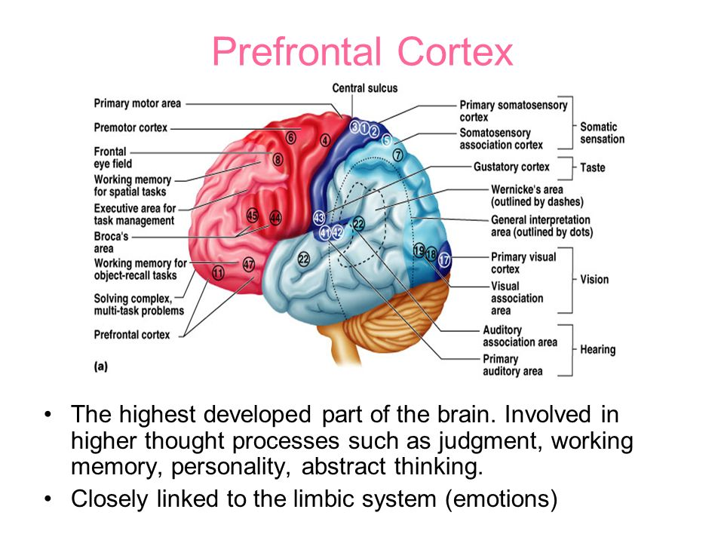

Slide 31
What is the impact of trauma on our brain?
When some experiences remind the trauma from the past, the brain reacts as if the trauma is happening in the ‘Here and Now’
So traumatised people keep on living in ‘there’ and ‘the past’ and seem to be unable to live and experience ‘their actual live’ in the ‘here and now’

Slide 32
Which diagnosis fits the best with these complex problems (chronic traumatization)?
Eating Disorder?
PTSD?
Dissociative disorder?
Borderline Personality Disorder?
Disorder of extreme stress (DESNOS)?

Slide 33
Disorders of extreme stress ?? (DESNOS)
1. Alteration in regulation of affect and impulses: affect regulation, modulation of anger, self-destructive, suicidal preoccupation, sexual promiscuity, risk taking, binge eating, vomiting,…
2. Alteration in attention and consciousness: amnesia, transient dissociative states and depersonalization

Slide 34
Disorders of extreme stress
3. Alteration in self-perception: ineffectiveness, permanent damage, guilt and responsability, shame, minimizing
4. Alterations in perception of perpetrator: adopting distorted beliefs, idealization of or preoccupation with perpetrator
5. Alteration in relations with others: inability to trust, revictimization, victimizing others

Slide 35
Disorders of extreme stress
6. Somatization: digestive system, chronic pain, cardiopulmonary symptoms, conversion, sexual symptoms, eating problems
7. Alterations in systems of meaning: despair and hopelesness, loss of previously sustaining beliefs
*Reference: Pelcovitz, van der Kolk, Roth, Mandel, Kaplan & Resick (1997) in J. of Traumatic Stress (vol 10, 1)

Slide 36
What about therapy?

Slide 37
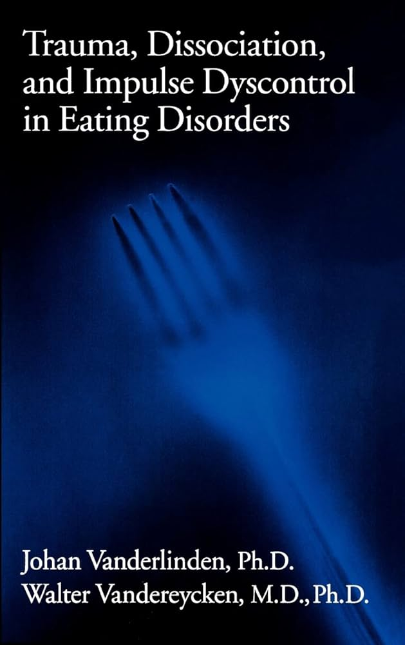
1993 1997(NY/ Brunner/Mazel)

Slide 38


Slide 39
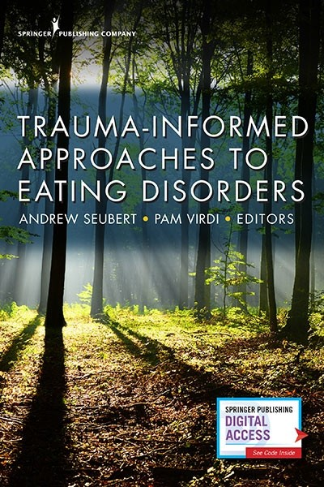
2018 (new edition february 2024)

Slide 40
There is some evidence and clinical guidelines for treatment ED in general: CBT transdiagnostic model + Family Therapy dominates treatment of Eating Disorders
BUT: among completers (80%) only 45% to 50% of the patients recover with CBT (Berkman, Lohr & Bulik, 2007; Fichter, 1997; 1998; 2004; 2008)
So there is still a long way to go and an important number of eating disorder patients make only little or no progress with the CBT approach

Slide 41
Maintaining factors in eating disorders
DYSFUNCTIONAL SELF-EVALUATION SCHEME
Over-evaluation of shape, weight and eating control
Clinical perfectionism
Core low self-esteem
Achieving in other domains
Strict diet
and other non compensatory weight control behaviors
Food checking
Body checking
Body avoidance
Preoccupation on shape, weight and eating control
Interpersonal problems
Binge eating
Labeling adverse event as “Feeling fat”
Mood intolerance
Compensatory behaviours
Adapted from: Fairburn et al, Behavior Research and Therapy 2003; 41: 509-528

Slide 42
I have my doubts!
I have my doubts that ‘the overevaluation of shape, weight and eating control’ is the core psychopathological feature in ED patients with a history of trauma
The eating disorder symptoms are often a unique way to cope with the aftermath and sequelae of the trauma

Slide 43
Motives for ED symptoms in trauma patients: clinical experiences
Thinness/fatness as a way to make the abused body sexually unattractive
Vomiting/purging/self-harming behaviours as a way to express feelings of disgust, dirtiness, to purify the body, to punish oneself
ED symptoms as a way to cope with the emotional consequences of the trauma
Hence in many patients the AN or BN symptoms becomes a survival strategy

Slide 44
Different pathways may lead to the development of ED’s*
The presence of trauma such as neglect and sexual abuse will need some specific interventions which are missing in the standard CBT approach and also in the standard clinical guidelines for ED’s
On the other hand: Existing PTSD guidelines lack also an ED focus!!
*Vanderlinden, J. (2008). Many Roads lead to Rome: Why does a Cognitive Behavioural Therapeutical Approach remain unsuccessful for many eating disorder patients. European Eating Disorders Review, 16, 1-5.

Slide 45
SOME SUGGESTIONS TOWARD THE DEVELOPMENT OF TREATMENT GUIDELINES FOR ED + PTSD and related comorbidity
See: Vanderlinden, J., & Vandereycken, W. (1997). Trauma, Dissociation, and Impulse Dyscontrol in Eating Disorders. New York: Taylor & Francis / Brunner/Mazel

Slide 46
Phase oriented treatment for ED clients with complex trauma: 3 phases
(1) stabilization and symptom reduction: regaining self-control
(2) eventually: psychotherapeutic treatment of traumatic experiences and memories
(3) reintegration and rehabilitation: long-lasting follow-up and aftercare

Slide 47
STABILIZATION and SYMTOM REDUCTION PHASE
STEP 1 Multi-dimensional assessment :
Eating Disorder
Psychiatrisch Comorbidty
Physical examination
Dissociation /PTSD
Time-line of important life events (including trauma)
Family background (with special focus on attachment)
Special attention to suicidality/automutilation/starvation/electrolyte disturbances/cardiac arrhythmia/hyperactivity/alcohol abuse, osteoporosis etc....
Social support

Slide 48
STABILIZATION and SYMTOM REDUCION PHASE
Step 2:
Providing structure, psychoeducation and safety and exploring motivation to change
Evaluating also readiness and/or inner strenghts for change

Slide 49
FASE 1: VERY FIRST STEP AFTER HAVING MOTIVATED THE PATIENT IS NORMALIZATION OF EATING HABITS AND WEIGHT
Psychotherapy is impossible with a starving brain
In the case of Anorexia Nervosa, patients need to be motivated to restart eating again.
The state of severe emaciation/low weight inhibits cognitive functions and concentration, has a negative impact on mood etc…
New learning needs food intake and subsequent protein and neurotransmitters synthesis
A concrete eating plan (step by step) is indicated (with the help of a dietician)

Slide 50
IMPORTANT STEP IN STABILISATION PHASE
RESTARTING TO EAT AGAIN IS THE FIRST STEP IN THE PROCESSING OF the TRAUMA THERAPY
when the patiens starts to eat again, she gives herself the message ‘I am good enough, I deserve to feed myself’ (very much challenging with her own self-esteem( for instance: I am bad or I do not deserve to be taken care for…)
FEEDING THE BODY is taking care for the body
So eating becomes a crucial step in the recovery of the trauma history but is often also very challenging

Slide 51
Challenge of trauma treatment and most important goal of any therapeutic intervention during the whole treatment
Develop a collaborative therapeutic alliance
Learning the patient to life in the ‘here and now’ again

Slide 52
Some trauma-specific therapeutic strategies in stabilisation phase: Treatment of choice does not exist
Dealing with hyper arousal and alertness: installing more inner control
Breathing exercises such as heart coherence training
Yoga, singing, playing music
Self-hypnosis to install inner security
Physical exercise/dance
Increasing self awareness
Become aware of your physical sensations: mindfulness !
Learn how slow breathing can change these physical sensations

Slide 53
Basic therapeutic goals in stabilisation phase:
Identify triggers that lead to losing control by means of eating + emotion diary
Confrontation with the body (for instance mirror exposure, massage, going on the weight scale, taking a shower, undress,….
Certain emotional states (loneliness, fear, anger,…)
Certain physiological states and bodily sensations (hyperactivity provoking a trance-like state, menstruation,…)
Normal eating or eating specific foods, smells, taste, colour… reactivate feelings and memories of the trauma experience

Slide 54
Basic therapeutic goals in stabilisation phase:
Develop a good social and support network
Traumatised people get only better in the context of save relationships
Traumatic experiences are a big challenge for the deveopment of the therapeutic alliance
My suggestion : evaluate every session by means of the session rating scale
Include some body work/massage/acupuncture in the therapeutic treatment

Slide 55

Session Rating Scale (SRS V.3.0) (© 2002, Scott D. Miller, Barry L. Duncan, & Lynn Johnson)
Relationship
I did not feel heard, understood, and respected.
I felt heard, understood, and respected.
I-------------------------------------------------------------------------I
Goals and Topics
We did not work on or talk about what I wanted to work on and talk about.
We worked on and talked about what I wanted to work on and talk about.
I------------------------------------------------------------------------I
Approach or Method
The therapist’s approach is not a good fit for me.
The therapist’s approach is a good fit for me.
I-------------------------------------------------------------------------I
Overall
There was something missing in the session today.
Overall, today’s session was right for me.
I------------------------------------------------------------------------I

Slide 56
Several challenges
More patients with severe trauma in residential setting
Often long duration of ilness with many hospitalizations
Family background of the patient: how to distance or collaborate?
Ongoing abuse
Ongoing self-harming behaviours
Both aspects: eating disorder and PTSD symptoms need our attention: difficult balance
Greater risk for revictimization experiences

Slide 57
Phase two: psychotherapeutic treatment of traumatic experiences and memories

Slide 58
Contra –Indications??
In the case of severe and long-lasting abuse starting at very young age
Ongoing abuse
Patient is not physically stable
Too low weight,
Frequently bingeing/vomiting/purging
Suicidality
Automutilation
Therapeutic alliance problematic
No social system outside the therapeutic system

Slide 59
Evidence-based treatment for complex trauma??
I believe that in no other field of psychotherapy so much progress has been made as is the case in the trauma field
This belief is supported by many evidence-based data

Slide 60
A large number of manualised treatments
Implosive desensitization (hypnotic technique) (Edelstein, 1982): psycho-education and exposure
EMDR (Shapiro, 1989, 1995): psychoeducation, exposure + cognitive processing
Cognitive (re) processing therapy for sexual assault victims (Resick & Snicke, 1992): psycho-education and exposure by writing

Slide 61
Implosive desensitization?
A hypnotique technique described by Edelstein (1982, trauma, trance and transformation,NY: Brunner/Mazel) )
To decrease the intensity of feelings associated with a traumatic event
A mild flooding technique (EXPOSURE) while in trance: after hypnotic induction, client is gradually exposed to the original trauma situation
After every exposure follows a short pauze to rest within a save place and to rate the anxiety/level of discomfort experienced during the exposure

Slide 62
What about EMDR in the treatment of Eating Disorders?
A recent study by Rossi and collegues (University of Florence, 2023) is very promising
They compared a sample of ED with trauma following either CBT-E alone or another sample with CBT-E + EMDR (20-25 sessions)
The condition CBT-E + EMDR showed better results and greater improvements especially with regard to decrease in general psychopathology and dissociative symptoms
The reduction in ED symptoms was mediated by the decrease in dissociation

Slide 63
Different (manualised) treatments
Trauma-focused cognitive-behavioural treatment (Foa & Rothbaum, 1991, 1993, 1999): psychoeducation, stress management, exposure and cognitive processing
Skills training in Affective and Interpersonal Regulation (STAIR) (Cloitre, M., 2006): psycho education, skills learning and exposure (narrative story telling)
Trauma Affect Regulation (TARGET; Ford, 2006): psycho-education + practical self-regulatory skills training

Slide 64
Different (manualised) treatments
Trauma Recovery and Empowerment Model (TREM; Harris, 1998): psycho-education + skills building approach
Brief Eclectic Therapy (BET, Schnyder, 2005, Vanderlinden & Vandereycken,1997): psycho education, skills training, eventually exposure
Trauma Focused Cognitive Behavioral Therapy (TFCBT) (Cohen, Mannarino, & Deblinger, 2006): psychoeducation, parenting skills and exposure

Slide 65
Different manualised treatments
Trauma Focused Cognitive Behavioral Therapy (TFCBT) (Cohen, Mannarino, & Deblinger, 2006): psychoeducation, parenting skills and exposure
Phase-oriented treatment à la Janet (van der Hart, Nijenhuis, Steele, 2007)
Integrative cognitive-affective therapy for BN (Stephen Wonderlich, 2015)

Slide 66
Yes, there is evidence for treatment of complex trauma: most manualised treatments share same treatment principles
All these treatments have many similarities
Most treatments are phase-oriented
In a FIRST phase psycho-education and skills training are offered: preparation phase installing safety
In a SECOND phase some exposure to important anxiety-provoking stimuli take place
The exposure provokes a lot a negative emotions and follows a specific treatment protocol with regular assessments of the level of negative emotions

Slide 67
Second Phase : treatment of traumatic memories and emotions
Exposure goes on until some desensitization of negative affect takes place as expressed by the subjective evaluation of the patient
In the second part: new adequate cognitive schema’s are installed or develop spontaniously
Important : first some emotional work needs to be done before new adequate cognitions can be installed

Slide 68
Second Phase : treatment of traumatic memories and emotions
Hypothesis based on neurobiological findings
1. First some activation of the amygdala (emotional brain) needs to be done but following a clear and save protocol: desensitization of negative affect: extinction of fear responses
2. After extinction of fear responses: cognitive restructuring activating hippocampus and logical thinking; the brain seems to open itself and to integrate new and more adequate information

Slide 69
Some data of a FU study (5 years) of dissociative experiences in ED clients with and without trauma Vanderlinden, J. (2012). Traitement des troubles dissociatifs et des conséquences de la traumatization chronique (p129-176). In: Kédia, Vanderlinden, Lopez et al (edit.) : Dissociation et Mémoire Traumatique. Paris: Dunod.
Only 51 clients scores on the 5 time points (5 year FU)
But no significant differences on client characteristics and other measurements at admission between this sample and the total sample
ED sample was divided between clients with trauma and high score on the DISQ ( a total DIS-Q score > 2.5 cutoff score for pathological dissociation; N=20) and patients reporting no trauma and low DIS-Q score (< 2.5 on DISQ total score; N=31)

Slide 70
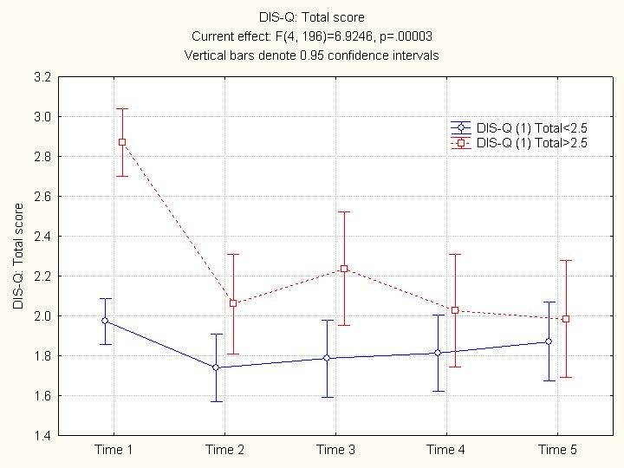

Slide 71
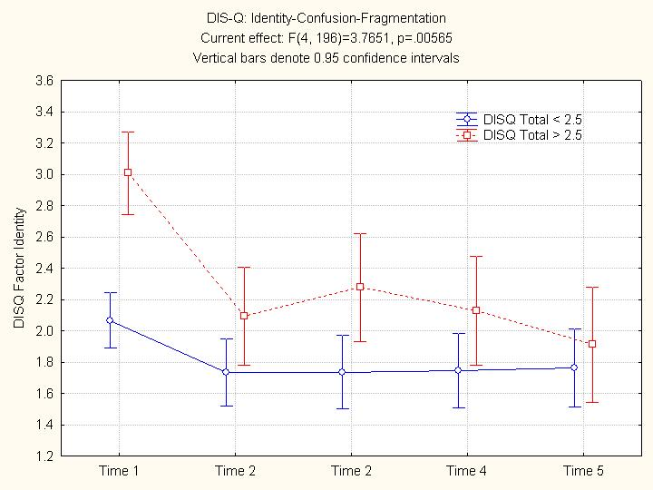

Slide 72
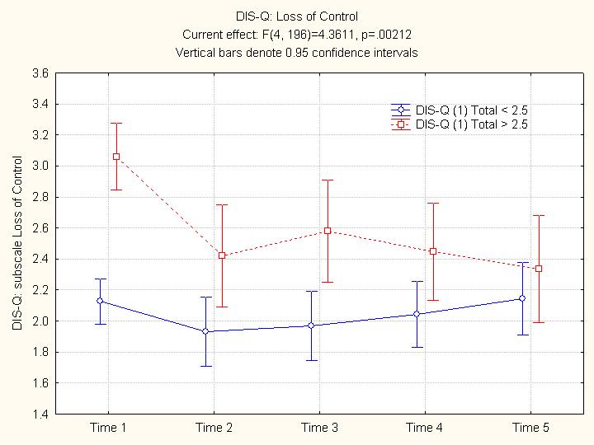

Slide 73
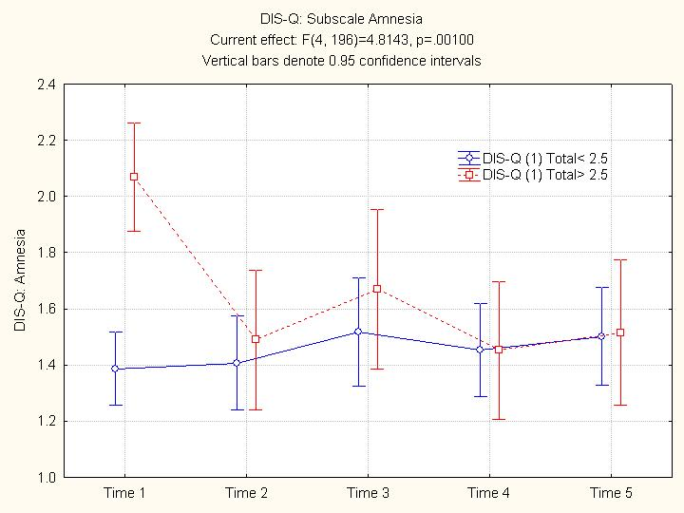

Slide 74
THERE IS HOPE

Slide 75
example
Young women of 28 years of age with BN problem
Lives with her parents; grows up in a invalidating family environment
Difficult relationship with her father; refuses to talk with her father for several years
Patient expresses ‘that something inside herself pushes her to go on with her bulimia’
She asks for exploration and finds out she needs to communicate with her father
Avoids confrontation with father but at the same time seems to be blocked/paralysed in her own life

Slide 76
example
With the CBT approach a lot of progress on the eating symptoms but says: ”something inside of me is sabotaging me and does not wants to give up the bingeing completely.”
One strong implicit belief: “I do not deserve to become happy; I have no right to have a happy life”

Slide 77
DVD example
Conversation with her father

