Slide 1
Treatment of PTSD in People with Serious Mental Illness:
A Cognitive Restructuring Approach
Kim T. Mueser, Ph.D.
Center for Psychiatric Rehabilitation
Boston University

Slide 2

Disclosure
All my clothes were made by my son, J. Mueser
Bespoke Hand Tailored Suits and Shirts, with stores in New York City:
J. Mueser
19 Christopher St.
New York, NY 10014
(347) 982-4382
http://jmueser.com

Slide 3
“TRAUMATIC” EVENT: DSM-V DEFINITION
An event involving some direct threat of death, severe bodily harm, or psychological injury to the self or another person.

Slide 4
COMMON TRAUMATIC EVENTS
Rape/ sexual abuse
Combat
Accidents
Crime/assault
Natural disasters (e.g., earthquake)
Sudden, unexpected death of a loved one
Traumatic events related to serious mental illness:
Psychotic symptoms (e.g., hallucinations, delusions)
Involuntary treatment (e.g., hospitalization, seclusion/restraints)
Being threatened in an inpatient setting

Slide 5
EPIDEMIOLOGY OF TRAUMA IN GENERAL POPULATION
36-81% report experiencing a traumatic event in their lifetime
National Comorbidity Survey of 6000 between 15-54:
  60% men exposed to traumatic event
  51% women exposed to traumatic event
  17% men & 13% women exposed to 3+ events
Even higher rates found in special subpopulations (e.g., homeless, serious mental illness, substance use disorders)

Slide 6
TRAUMA IN PERSONS WITH SEVERE MENTAL ILLNESS
Trauma and other adverse events in childhood increase risk of developing SMI
High rates of trauma in SMI
Multiple traumatization is common
History of trauma associated with more severe symptoms and distress
Service users report traumatic experiences are important but neglected in treatment

Slide 7
TRAUMA IN SMI (N=275)
Source: Mueser et al. (1998)

Slide 8
WHY FOCUS ON PTSD?
Most established psychiatric consequence of trauma exposure
High prevalence in general population, but even higher in vulnerable populations:
  Estimated prevalence of PTSD in SMI in 29-33 studies was 30-33% (Mauritz et al., 2013; Zammit et al., 2018)
PTSD often undetected in SMI population (<5% in many studies), suggest high unmet need
PTSD associated with increased distress and acute care service utilization
Assessment straightforward
Psychological treatments shown to be effective
Pharmacological treatments also beneficial

Slide 9
DSM-5 SYMPTOMS OF PTSD
Exposure to traumatic event
Symptom criteria:
Intrusion symptoms (e.g., intrusive memories, flashbacks, nightmares)
Avoidance of trauma-related stimuli (e.g., avoiding memories, situations related to trauma)
Over-arousal (e.g., hypervigilance, difficulty sleeping, anger outbursts, exaggerated startle)
Negative alterations in cognition or mood (e.g., inability to remember parts of event, persistent negative feelings, detachment from others)

Slide 10
OTHER COMMON SYMPTOMS RELATED TO PTSD
  Depression
  Guilt
  Suicidality, self-injurious behavior
  Substance abuse
  Hallucinations
  Mild delusions (e.g., paranoia)

Slide 11
INTERACTIVE MODEL OF TRAUMA, PTSD, & CO-OCCURRING DISORDERS (MUESER ET AL., 2002)
TRAUMA
SUBSTANCE
ABUSE
TRAUMA
HISTORY
SYMPTOM SEVERITY
& FUNCTIONING
PTSD
ILLNESS
MANAGEMENT
SERVICES
WORKING
ALLIANCE

Slide 12
TREATMENT OF PTSD IN GENERAL POPULATION
CBT is most widely studied & replicated intervention, with primary support for:
  Exposure therapy (ET): Prolonged exposure to safe but anxiety-provoking, trauma-related stimuli (imaginal & in vivo) leads to emotional processing of event & habituation of fear (e.g., Foa)
  Cognitive restructuring (CR): Identifying, challenging, & changing upsetting, inaccurate trauma-related thoughts & beliefs underlying PTSD; facilitates incorporation of trauma experiences into view of self, others, and the world (e.g., Ehlers & Clark)
ET and CR equally effective, as is combination of ET + CR
Eye Movement Desensitization and Reprocessing (EMDR) also effective (Shapiro); combines exposure and CR components

Slide 13
EXCLUSION CRITERIA IN TREATMENT RESEARCH
Studies in general population rule most or all people with SMI and PTSD: psychosis, suicidal ideation, cognitive impairment, recent medication changes, and severe medical problems
Consensus statement by leaders in trauma research:
  Simple or “pure” PTSD is unrepresentative of the typical presentation of treatment seeking individuals with trauma histories
Spinazzola et al. (2005): “True advancement of the field will require a deliberate process of evaluation and adaptation of efficacious treatments with less restricted, more clinically representative PTSD samples.” (p. 427)

Slide 14
RATIONALE FOR SELECTING COGNITIVE RESTRUCTURING
Higher acceptability of cognitive restructuring over exposure-based therapies (prolonged exposure, EMDR) due to not requiring clients to overcome avoidance of trauma-related stimuli in order to participate in treatment
Exposure therapy less effective when anxiety is not dominant emotion (e.g., guilt/shame, anger, depression)
Concern over “retraumatizing” vulnerable clients through exposure, leading to a worse symptoms (e.g., psychosis, suicidality, substance abuse, self-injurious behavior)
In contrast to exposure-based programs, CR program teaches useful life skills beyond just treatment of PTSD

Slide 15
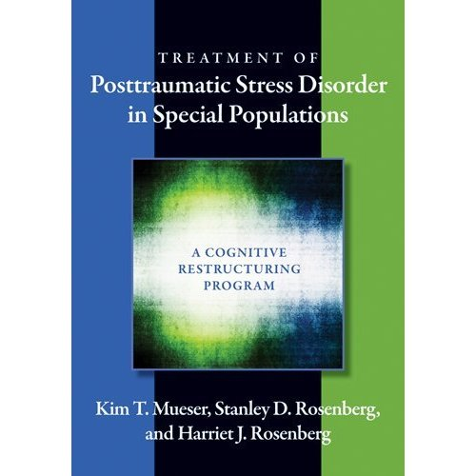

Slide 16


Slide 17
FORTHCOMING
Mueser, K. T., & Gottlieb, J. D. (in press). Treatment of Posttraumatic Stress Disorder in Serious Mental Illness: The Cognitive Restructuring Program. Washington, DC: American Psychological Association.
With all educational handouts and worksheets available in both English and Spanish

Slide 18
LOGISTICS
12-16 week manualized CBT treatment (depending on population)
Individual weekly sessions
Treatment provided at local community mental health centers, addiction settings, schools, or other community locations
8 therapy modules for basic program

Slide 19
SYMPTOM MONITORING
Self-reported assessment of PTSD (PCL) and depression (BDI) at beginning of first and every third session thereafter
Used to track outcomes over treatment
Client responses scored and briefly discussed with therapist at beginning of session
Sometimes assessments used to address distressing symptoms (e.g., use cognitive restructuring to target upsetting feelings related to trauma-related thoughts identified on PCL)

Slide 20
THERAPY MODULES
Overview
Distress response plan
Breathing retraining
Psychoeducation I
Psychoeducation II
Cognitive restructuring I
Cognitive restructuring II
Generalization Training & Termination

Slide 21
MODULE 1: OVERVIEW
Review of overall program
Discussion of psychoeducation, breathing retraining, cognitive restructuring
Logistics of treatment program
Homework, cancellations, etc.

Slide 22
MODULE 2: DISTRESS RESPONSE PLAN
Identification of warning signs of increased distress
Exploration of social supports
Agreement on monitoring strategies
Formulation of crisis plan
Discussion of who to involve in crisis

Slide 23
MODULE 3: BREATHING RETRAINING
Education about impact of breathing on anxiety
Instructions on how to modify breathing to reduce anxiety
In-session practice and assigned homework

Slide 24
MODULES 4-6: EDUCATION
Covers PTSD symptoms and associated problems
Interactive
frequently and ask questions to help clients relate information to their own experiences
Adopt client’s language
Use worksheets to help clients identify their own symptoms and trauma consequences
Complete some worksheets in session; assign homework to complete others
Ask review questions to check client understanding
Abbreviate material when working with severely impaired clients

Slide 25
MODULE 6: COGNITIVE RESTRUCTURING I
Cognition-emotion-behavior model
Common styles of thinking
  All or nothing thinking
  Overgeneralization
  “Must,” “should,” or “never” statements
  Catastrophizing
  Emotional reasoning

Slide 26
MODULE 6: COGNITIVE RESTRUCTURING I
Normalized common styles as errors everyone makes, but may be more common in PTSD
Explain how correcting common styles can reduce negative feelings associated
For each style, briefly explain, try to elicit personal examples from client
When example elicited, explore why it is a common style (i.e., why inaccurate) and identify more accurate thought
1-3 sessions

Slide 27
MODULE 7: COGNITIVE RESTRUCTURING II
5 steps of cognitive restructuring:
  Describe situation
  Identify strongest emotion
  Identify strongest thought or belief (“Guide to Thoughts and Feelings”)
  Evaluate the thought
  Take action: Either change the thought, develop an action plan to deal with the situation, or both

Slide 28
5 STEPS OF COGNITIVE RESTRUCTURING
1. Situation
Ask yourself, “What happened that made me upset?” Write down a brief description of
the situation.
____________________________________________________________________
2. Feeling
Circle your strongest feeling:
Fear/Anxiety Sadness/Depression Guilt/Shame Anger
3. Thought
Ask yourself, “What am I thinking that is leading me to feel this way?” Write down your thoughts below:
_____________________________________________________________________
_____________________________________________________________________
Is this thought a Common Style of Thinking? If yes, circle the one:
All-or-Nothing Over-Generalizing Must/Should/Never
Catastrophizing Emotional Reasoning Overestimation of Risk
Self-Blame Mental Filter

Slide 29
4. Evaluate Your Thought: Now ask yourself, “What evidence do I have for this thought?” Write down the answers that do support your thought and the answers that do not support your thought. Things that DO support my thought: _________________________________________________________________________ _________________________________________________________________________ _________________________________________________________________________ Things that DO NOT support my thought: _________________________________________________________________________ _________________________________________________________________________ _________________________________________________________________________ 5. Take Action! Next, ask yourself, “Do things mostly support my thought or do things mostly NOT support my thought?” □ NO, the evidence does not support my thought. Come up with a new thought that is supported by the evidence. New Thought___________________________________________________________________________ YES, the evidence does support my thought. Decide what you need to do next in order to deal with the situation. Write down your Action Plan for dealing with the upsetting situation: Action Plan: _____________________________________________________ _______________________________________________________________

Slide 30
RESEARCH ON CBT FOR PTSD IN SMI MODEL
2 open pilot feasibility studies, 1 in NH, 1 in NJ
RCT comparing CBT for PTSD (severe) with treatment as usual (TAU) in rural NH/VT (Mueser et al., 2008)
RCT comparing CBT for PTSD (severe) with Brief program in urban NJ (Mueser et al., 2015)
RCT comparing CBT with usual care for people with schizophrenia and PTSD (not severe)
Open pilot of Brief program as stand-alone program
Closed enrollment group format version of program implemented in community mental health center
Pilot of stepped care program, including Brief program, followed by open-enrollment group format (for clients with persistent PTSD

Slide 31
RCT OF CBT FOR PTSD IN NH
(Mueser et al., 2008)
RCT of CBT vs. TAU (N = 108; 15% schizophrenia-spectrum, 85% major mood disorder, 25% borderline personality disorder)
Exposure to CBT: 81%
Conducted at 4 local CMHCs in NH & VT
CBT provided by 6 Ph.D. & 1 M.A. clinician
Assessments conducted at baseline, post-treatment, 3-months, 6-months
Primary focus on PTSD knowledge, trauma-related beliefs, PTSD, other symptoms

Slide 32
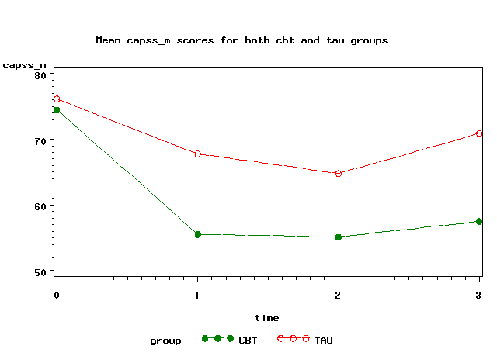

Slide 33
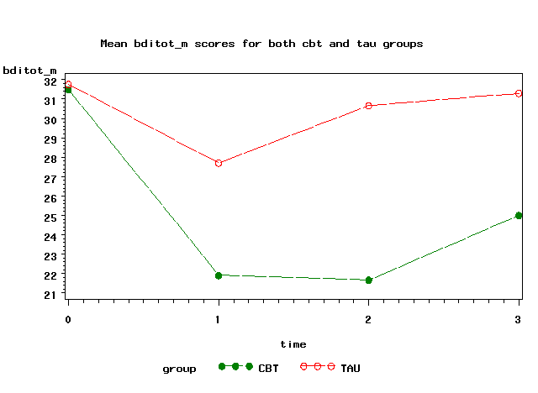

Slide 34
NJ CBT FOR PTSD RCT
Collaboration with UNDMJ/UBHC in New Jersey
Conducted at 5 sites in urban settings, more minority clients
Evaluation of CBT for PTSD when delivered by frontline clinicians
Comparison of CBT to Brief Treatment
Assessment of longer-term functional outcomes, services, & costs
Larger sample: N = 201 (33% schizophrenia-spectrum, 67% major mood, 28% borderline personality disorder)
Funded by NIMH
Pilot study conducted in NJ to establish feasibility of implementing program at study sites (Lu et al., 2011)

Slide 35
RCT STUDY DETAILS
Adults with SMI and severe PTSD at 5 mental health clinics in NJ
Randomized to either CBT or Brief intervention, stratified by site, SMI diagnosis, and gender
Assessed at BL, Post-treatment, 6 month, and 1 year follow-up
Treatment delivered by trained frontline clinicians

Slide 36
ELIGIBILITY CRITERIA
SMI according to state of NJ
Axis I diagnosis of schizophrenia, schizoaffective, bipolar, or major depression (borderline PD accepted)
Current diagnosis of severe PTSD (CAPS Total 65 or higher)
No hospitalization or suicide attempt past 3 months
Not dependent on substances
Receiving mental health services
Willing and able provide informed consent

Slide 37
BRIEF TREATMENT INTERVENTION
3 weekly individual sessions
2 main components:
1) Breathing retraining skill
2) Psychoeducation about PTSD
Use of manual, client worksheets, plus a DVD for psychoeducation piece
Modified since study, now called Brief Relaxation, Education, And Trauma HEaling (BREATHE)

Slide 38
PRIMARY (PTSD) OUTCOMES
Significant differences favoring CBT over Brief found in:
  PTSD symptom severity (CAPS Total & subscales)
  PTSD diagnosis
  Knowledge of PTSD
  Social functioning affected by PTSD

Slide 40
SECONDARY OUTCOMES
Significant differences favoring CBT over Brief for global functioning (GAF)
Significant group X time interactions for social functioning and BDI
  More rapid improvement for CBT than Brief
No group differences in:
  Depression or other symptoms
  Post-traumatic cognitions
  Overall quality of life

Slide 42
COMPARISON OF NH & NJ STUDIES
Is Brief intervention delivering a treatment benefit?
Focus on NH sample with severe PTSD (75% of total sample)
Examination of CAPS Total, PTSD Knowledge, BDI, and PTCI
CAPS change:
  CBT in NH = 20 points
  CBT in NJ = 23 points
  TAU in NH = 9 points
  Brief in NJ = 15 points

Slide 43
Mental Health Care Costs (2010 $) Per Participant,
First 12 Months After Baseline: No Differences Between CBT and Brief

Slide 44
DISSEMINATION COST-EFECTIVENESS
CBT is more effective than Brief, but high cost per PTSD remission: $33,815
However, Brief has lower implementation costs per clinician:
  $1853 per clinician for Brief versus $6190 per clinician for CBT
Brief is also shorter in duration:
  Brief takes 3 sessions versus 12-16 sessions for CBT
Implies that an investment in implementing Brief would likely result in more PTSD remissions per year than would an equal investment in CBT
  We estimate that a given investment in Brief will result in 9.0 times as many remissions from PTSD as an equal investment in CBT
    More clinicians trained
    More patients seen per unit of time

Slide 45
DISCUSSION
CBT for PTSD program effective in treating PTSD and related outcomes in people with SMI
NJ study showed:
  Predominantly minority clients living in poor, urban areas benefit from CBT for PTSD program
  Diagnostically heterogeneous sample: two-thirds major mood disorders, one-third psychotic disorders, 25% also had borderline personality disorder
  Frontline clinicians can implement program with good fidelity
  Effects sustained for 1 year
  Cognitive restructuring component of CBT program most critical to improving PTSD in SMI
  Brief program appeared to produce benefit in PTSD and other symptoms
First and only intervention shown to improve PTSD in SMI in RCTs

Slide 46
FUTURE DIRECTIONS
Brief treatment for PTSD: An effective treatment?
Reduced difference between CBT and treatment as usual in first RCT (NH/VT) by more than 50% in second RCT (NJ)
Higher rates of completion in NJ study, especially in outpatient settings with high rates of no-show
Easier to train clinicians in, easier to implement
Positive effects of Brief treatment recently by Nishith et al. (2015)
Adaptations of Brief treatment (now called BREATHE) to adolescents screened in primary care, homeless persons, persons in lower and middle income countries
Potential role of BREATHE in stepped care for PTSD?
  First provide BREATHE
  Then provide CR for clients who continue to have PTSD symptoms

